Slide 1


Restaurant Menu Website
Guided By:
Dr. L.Reetha
CSA4317 – Internet Programming For Mobile Web Integration
Saveetha School of Engineering,
SIMATS.
Presented By:
K. Someshwar Reddy
(192210045)
B. Revanth Harsha Vardhan
(192210076)

Slide 2
ABSTRACT:
This project aims to create a user-friendly website that allows customers to view the menu offerings of our restaurant from the comfort of their own homes.
The Restaurant Menu web application which is designed using Python concepts provides a wide range of free accessibility of ordering food items through online.
This mainly offers various types of features for customers like: Ordering food items, browse for new food varieties, and also with online food bill payment using UPI apps or credit and debit cards.
This system mainly provides the features by offering various types of food ordering techniques through online, which makes the customers to easily get their favourite food to their place within an hour after ordering the food in a particular restaurant near by the customers.

Slide 3
INTRODUCTION
A restaurant's website is an online identity, providing customers with a virtual view into the restaurant menu.
These websites include essential details including menus, opening times, location information, and contact details for both fine dining places and casual dining spots.
Having a website is crucial for businesses to attract more customers and offer simple access to their services in the modern digital world. We want to build a website that is easy to use so that customers may browse our restaurant's menu from the convenience of their own homes.
Our aim to create a restaurant menu website is a big step forward in utilizing modern technology to improve customer experience and promote business growth.

Slide 4
BENEFITS
Improved Customer Experience: The restaurant menu website project aims to enhance the overall customer experience by providing a user-friendly interface and interactive features.
Cost - effectiveness: Compared to traditional advertising methods, maintaining a website is a cost-effective way for the restaurant to promote its menu and attract customers. Once the website is developed, ongoing maintenance costs are relatively low, making it a sustainable investment for the long term.
Increased Visibility: By establishing an online presence, the restaurant can reach a wider audience beyond its physical location. A well-designed website with enticing images and detailed descriptions of menu items can attract potential customers searching for dining options online.
Convenience for Customers: The website provides convenience for customers by allowing them to browse the menu, explore options, and make informed decisions from the comfort of their own homes. This can be particularly appealing for busy individuals or those looking to plan their meals in advance.

Slide 5
ADVANTAGES & DISADVANTAGES
Advantages:
Security
Performance
Improved Customer Experience
Accessibility
Disadvantages:
Initial Development Cost
Security Concerns
Dependency on Internet Connectivity
Servers Maintenance

Slide 6
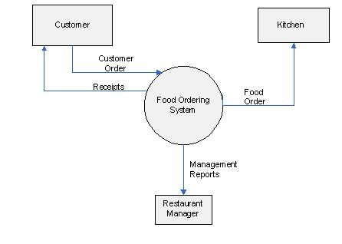
Diagrammatic Representation of Restaurant Menu Website

Slide 7
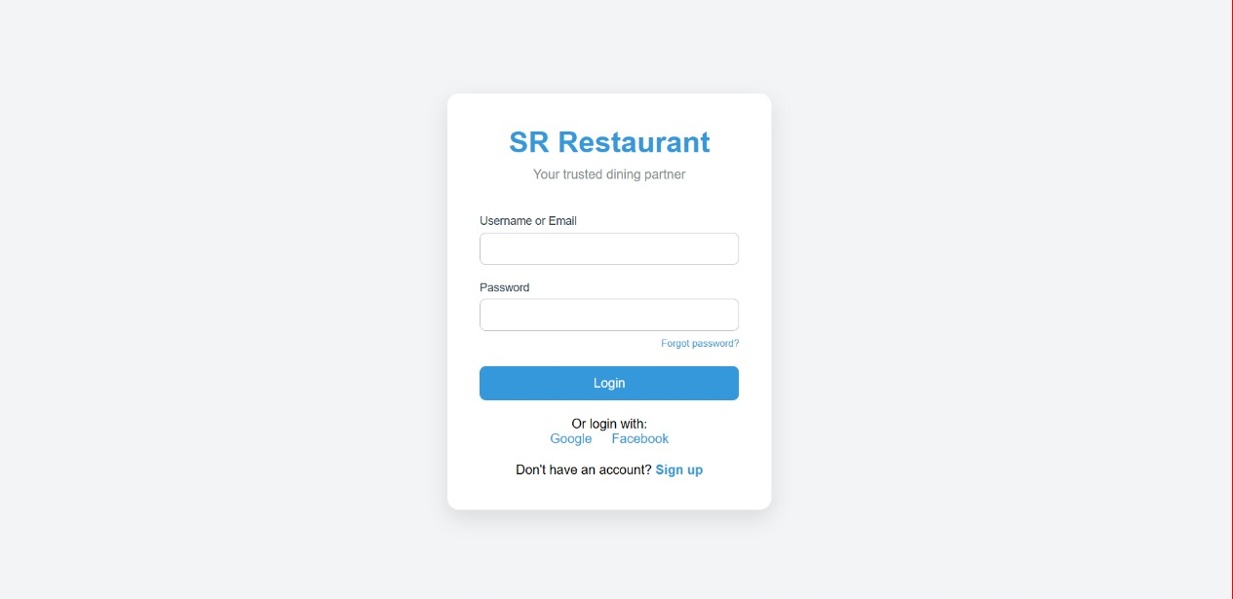
Website Login Page

Slide 8
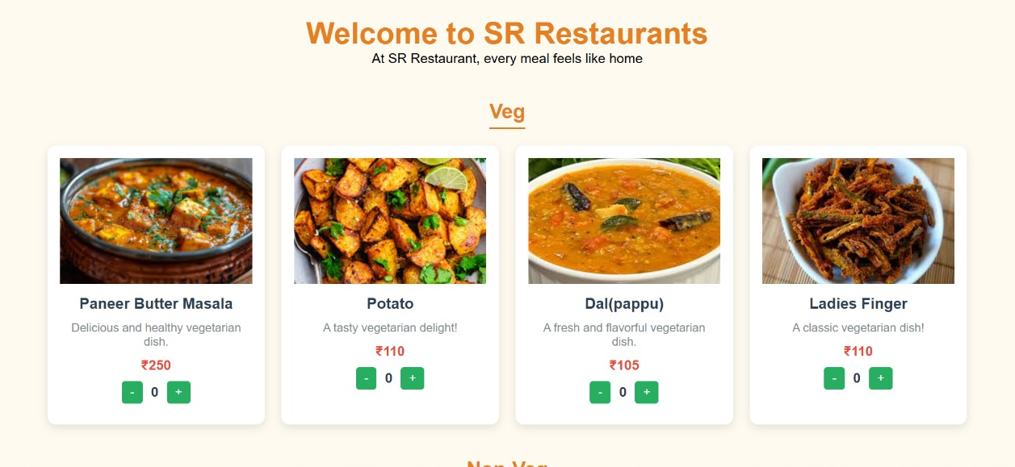
Restaurant Dashboard

Slide 9
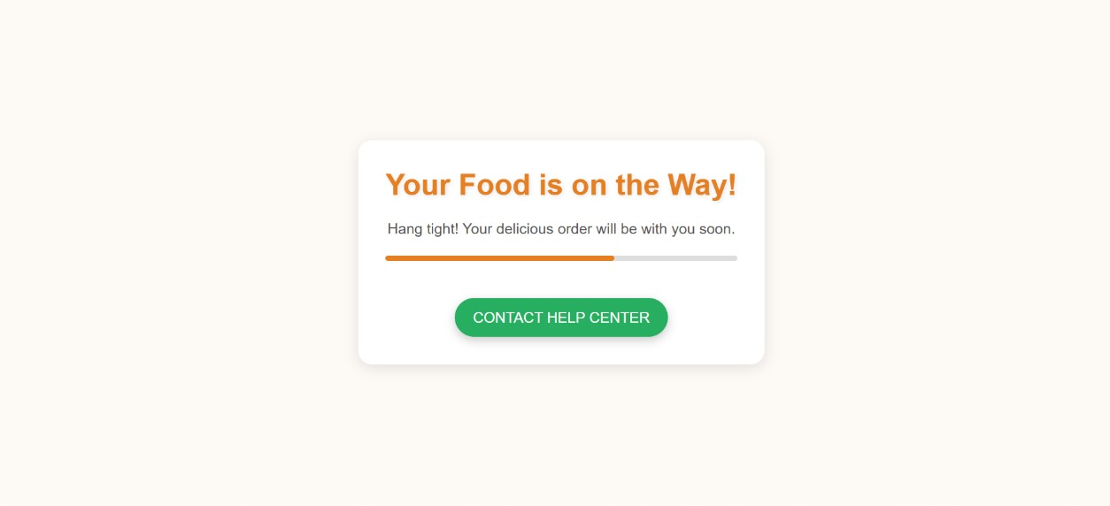
Order Confirmation Page

Slide 10

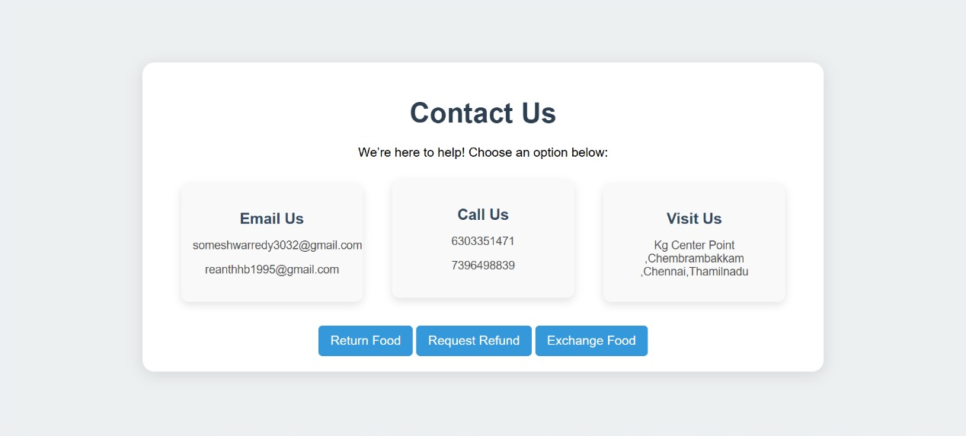
Contact Support Team

Slide 11
Conclusion:
In conclusion, the development of a restaurant menu website using Python presents an exciting opportunity to enhance the digital presence and customer experience of our restaurant.
Our website not only serves as a virtual storefront for showcasing our culinary creations but also as a hub for connecting with our customers, gathering valuable feedback, and optimizing our offerings based on their preferences.
With our restaurant menu website, we look forward to expanding our reach, strengthening customer relationships, and achieving greater success in the competitive restaurant industry.

Slide 12


